Slide 1
Artificial Neural Networks
Feed- Forward and Back-Propagation Algorithm
Course Supervisor: ANAUM HAMID

Slide 2
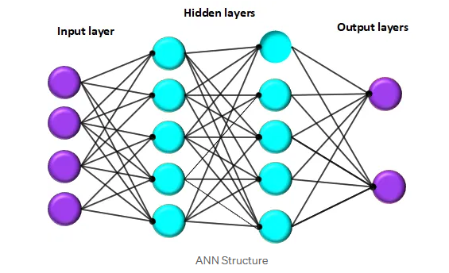
Artificial Neural Network (ANN)
An Artificial Neural Network (ANN) is a computational model inspired by the human brain. It’s designed to recognize patterns and relationships in data by mimicking how biological neurons signal and process information.
📐 ANN Architecture Overview
An ANN consists of three main types of layers:
Input Layer: Receives the initial data (features).
Hidden Layer(s): Processes data and extracts patterns (can be one or many layers).
Output Layer: Produces the final prediction (e.g., class label or value).
Each layer contains neurons (nodes) connected to neurons in the next layer via weights.

Slide 3
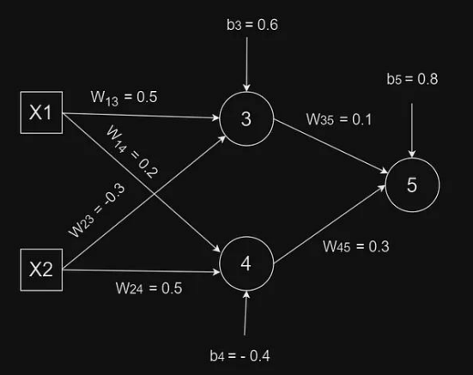
Network Architecture & Initial Values
Weight/Bias | Value
W₁₃ | 0.5
W₁₄ | 0.2
W₂₃ | −0.3
W₂₄ | 0.5
W₃₅ | 0.1
W₄₅ | 0.3
b₃ | 0.6
b₄ | −0.4
b₅ | 0.8
Key Parameters:
• Learning rate (l) = 0.5
• Activation: Sigmoid
σ(x) = 1/(1+e⁻ˣ)
• Training tuples: (1,1,0) and (0,1,1)
Initial Weights & Biases

Slide 4
Forward Pass — Iteration 1 | Input: (X₁=1, X₂=1, Target=0)
① INPUT LAYER
O₁ = I₁ = 1 O₂ = I₂ = 1
② HIDDEN LAYER — Node 3
② HIDDEN LAYER — Node 4
③ OUTPUT LAYER — Node 5
I₃ = O₁ × W₁₃ + O₂ × W₂₃ + b₃
= 1×0.5 + 1×(−0.3) + 0.6
= 0.5 − 0.3 + 0.6 = 0.8
O₃ = σ(0.8) = 1/(1+e⁻⁰·⁸)
O₃ = 0.6900
→
I₄ = O₁ × W₁₄ + O₂ × W₂₄ + b₄
= 1×0.2 + 1×0.5 + (−0.4)
= 0.2 + 0.5 − 0.4 = 0.3
O₄ = σ(0.3) = 1/(1+e⁻⁰·³)
O₄ = 0.5744
→
I₅ = O₃×W₃₅ + O₄×W₄₅ + b₅
= 0.69×0.1 + 0.5744×0.3 + 0.8
= 0.069 + 0.1723 + 0.8
= 1.0413
O₅ = σ(1.0413) = 1/(1+e⁻¹·⁰⁴¹³)
O₅ = 0.7391
Predicted Output O₅ = 0.7391 | Target τ = 0 | Error exists → Backpropagate!

Slide 5
Backpropagation — Error Calculation
Output Layer Formula: Errⱼ = Oⱼ (1 − Oⱼ)(Tⱼ − Oⱼ)
Hidden Layer Formula: Errⱼ = Oⱼ (1 − Oⱼ) × Σ Errₖ × wⱼₖ
ERROR AT OUTPUT NODE 5
ERROR AT HIDDEN NODE 4
Err₅ = O₅ (1 − O₅)(τ − O₅)
= 0.7391 × (1 − 0.7391) × (0 − 0.7391)
= 0.7391 × 0.2609 × (−0.7391)
= −0.1425
Err₄ = O₄(1−O₄)(Err₅ × W₄₅)
= 0.5744 × (1−0.5744) × (−0.1425 × 0.3)
= 0.5744 × 0.4256 × (−0.04275)
= −0.010451
ERROR AT HIDDEN NODE 3
Error Summary
Err₃ = O₃(1−O₃)(Err₅ × W₃₅)
= 0.69 × (1−0.69) × (−0.1425 × 0.1)
= 0.69 × 0.31 × (−0.01425)
= −0.030481
Err₅ = −0.1425
Err₃ = −0.030481
Err₄ = −0.010451

Slide 6
Weight & Bias Updates
Weight Update: Wᵢⱼ(new) = Wᵢⱼ(old) + l × Oᵢ × Errⱼ
UPDATED WEIGHT VALUES
Bias Update: bⱼ(new) = bⱼ(old) + l × Errⱼ
W₄₅(new)
= 0.3 + 0.5×0.5744×(−0.1425)
= 0.2591
UPDATED BIAS VALUES
W₃₅(new)
= 0.1 + 0.5×0.69×(−0.1425)
= 0.0508
b₃ = 0.6 + 0.5×(−0.030481) = 0.5848
b₄ = −0.4 + 0.5×(−0.010451) = −0.4052
b₅ = 0.8 + 0.5×(−0.1425) = 0.7288
W₂₄(new)
= 0.5 + 0.5×1×(−0.010451)
= 0.4948
W₁₄(new)
= 0.2 + 0.5×1×(−0.010451)
= 0.1948
W₂₃(new)
= −0.3 + 0.5×1×(−0.030481)
= −0.3152
W₁₃(new)
= 0.5 + 0.5×1×(−0.030481)
= 0.4848

Slide 7
Iteration 2 Forward Pass | Input: (X₁=0, X₂=1, Target=1)
Updated weights: W₁₃=0.4848 W₁₄=0.1948 W₂₃=−0.3152 W₂₄=0.4948 W₃₅=0.0508 W₄₅=0.2591 b₃=0.5848 b₄=−0.4052 b₅=0.7288
Hidden Node 3 (X₁=0, X₂=1)
Hidden Node 4 (X₁=0, X₂=1)
I₃ = 0×0.4848 + 1×(−0.3152) + 0.5848
= 0 − 0.3152 + 0.5848 = 0.2696
O₃ = σ(0.2696) ≈ 0.567
I₄ = 0×0.1948 + 1×0.4948 + (−0.4052)
= 0 + 0.4948 − 0.4052 = 0.0896
O₄ = σ(0.0896) ≈ 0.522
Output Node 5
I₅ = O₃×W₃₅ + O₄×W₄₅ + b₅ = 0.567×0.0508 + 0.522×0.2591 + 0.7288
= 0.0288 + 0.1352 + 0.7288 = 0.8928
O₅ = σ(0.8928) ≈ 0.710
Network is learning! Target=1 | O₅ improved toward target | Continue backpropagation with Err₅ = O₅(1−O₅)(1−O₅)

Slide 8
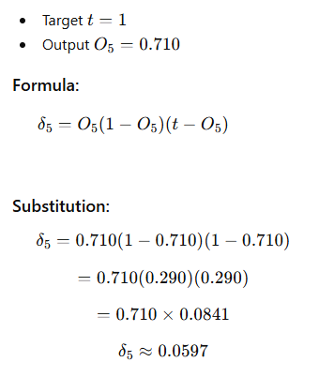
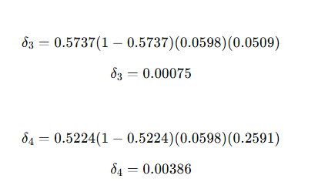
Iteration 2 Backpropagation — Error Calculation

Slide 9
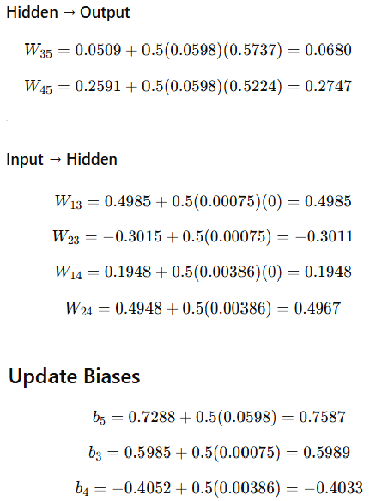
Iteration 2 Weight & Bias Updates
Weight/Bias | Value
W13 | 0.4985
W23 | -0.3011
W14 | 0.1948
W24 | 0.4967
W35 | 0.0680
W45 | 0.2747
b3 | 0.5989
b4 | -0.4033
b5 | 0.7587
Positive error means output is lower than target.
Network will increase weights contributing positively to output.
This helps push O₅ ​ closer to 1 in future iterations.

Slide 10
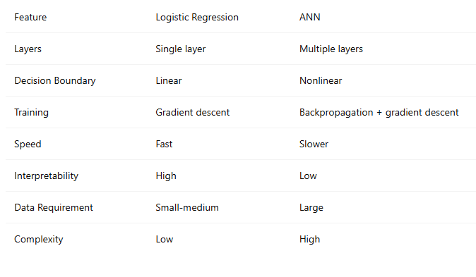
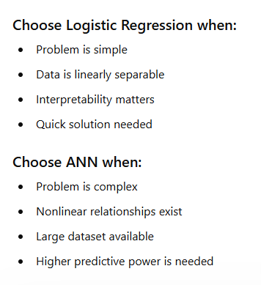
Core Comparison

Slide 11
Summary & Key Takeaways
🔄 Algorithm Steps
📐 Key Formulas
✅ Iteration 1 Results
1. Initialize weights & biases
Output error: Oⱼ(1−Oⱼ)(Tⱼ−Oⱼ)
Initial O₅ = 0.7391 (target = 0)
2. Feed-forward: compute outputs
Hidden error: Oⱼ(1−Oⱼ) Σ Errₖwⱼₖ
Err₅ = −0.1425
3. Calculate error at output
Weight update: Wᵢⱼ + l × Oᵢ × Errⱼ
After update: O₅ = 0.710
4. Backpropagate error to hidden layers
Bias update: bⱼ + l × Errⱼ
New Err₅ = 0.0597
5. Update all weights & biases
Sigmoid: σ(x) = 1/(1+e⁻ˣ)
Network is converging ✓
6. Repeat until convergence
Training continues iterating over all tuples until the global error is minimized (convergence)

